Slide 1
FINAL PROJECT
Peter Sanchez
November 24, 2021

Slide 2
PROJECT OBJECTIVE
Build Model to predict whether a loan will be charged off based on features available at loan origination

Slide 3
DATA IDENTIFICATION AND GATHERING
Data sources were purposefully limited to readily available datasets in the current work environment.
Desire to repeat and refine the processes developed in the Project
Indirect feedback on the existing data’s integrity
Datasets identified:
New Loans Opened
Loans Charged-off

Slide 4
DATA GATHERING
Loans made from 11/1/2015 through 10/31/2019
Loans charged-off as of 10/31/2021
Joining the two tables (PostgreSQL) produced a population of loans originated over a four-year period where each loan’s charge-off status was known. The “youngest” loans had at least 24 months to charge off. This aligned with observations that a large proportion of charge-offs occurred within 24 month of origination.

Slide 5
DATA ANALYSIS AND CLEANING
Cleaning
Fill in NaNs
Replace “No Score” with “0”
Reformat numbers and headers
Delete loans with no Debt Ratio
lost 5,865 loans, including 444 that charged-off (new total - 16,643 with 731 charged-off)

Slide 6
MACHINE LEARNING MODEL
Balanced Random Forest Classifier selected
Performance impressive based on Module 17 Challenge
Outperformed non-ensemble models
Satisfied desire to rank importance of features
Feature selection
Used all features available in dataset obtained
Decision on which to ultimately used would be based on performance of model
Data was split and trained using train_test_split
Data was scaled using StandardScaler

Slide 7
INITIAL MODEL PERFORMANCE
Balanced Accuracy Score - 0.6542
Recall - 0.59

Slide 8

INITIAL MODEL - CONFUSION MATRIX
 | Predicted “Good” | Predicted “Charge-off”
Actual “Good” Loan | True “Good” | False “Charge-off”
Actual “Charge-off” Loan | False “Good” | True “Charge-off”
 | Predicted “Good” | Predicted “Charge-off”
Actual “Good” Loan | MAXIMIZE | REDUCE
Actual “Charge-off” Loan | MINIMIZE | MAXIMIZE

Slide 9
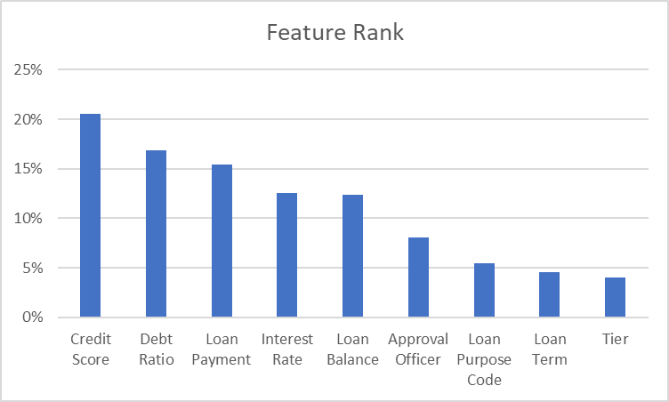
MODEL OPTIMIZATION

Slide 10
MODEL OPTIMIZATION
Changing bin cutoff of loanpurposecode
Changing n_estimators
Using various combinations of features based on feature_importances_

Slide 11
BEST MODEL PERFORMANCE
 | BAS | Recall
Initial Model | 0.6542 | 0.59
Best Model | 0.6584 | 0.60

Slide 12

BEST MODEL - CONFUSION MATRIX
 | Predicted “Good” | Predicted “Charge-off”
Actual “Good” Loan | MAXIMIZE | REDUCE
Actual “Charge-off” Loan | MINIMIZE | MAXIMIZE
INITIAL
BEST

Slide 13

USER INPUT VERSION
Reduced features
Non-scaled
Balanced Accuracy Score - 0.6313
Recall - 0.61

Slide 14
ANALYSIS AND NEXT STEPS
Database may not include features that may be useful in predicting charge-off
Length of employment
Other life events
Keeping input simple forced decision to delete some features
Additional code for dropdowns, etc. could allow use of better performing model
Model may improve with more training data

